Slide 1

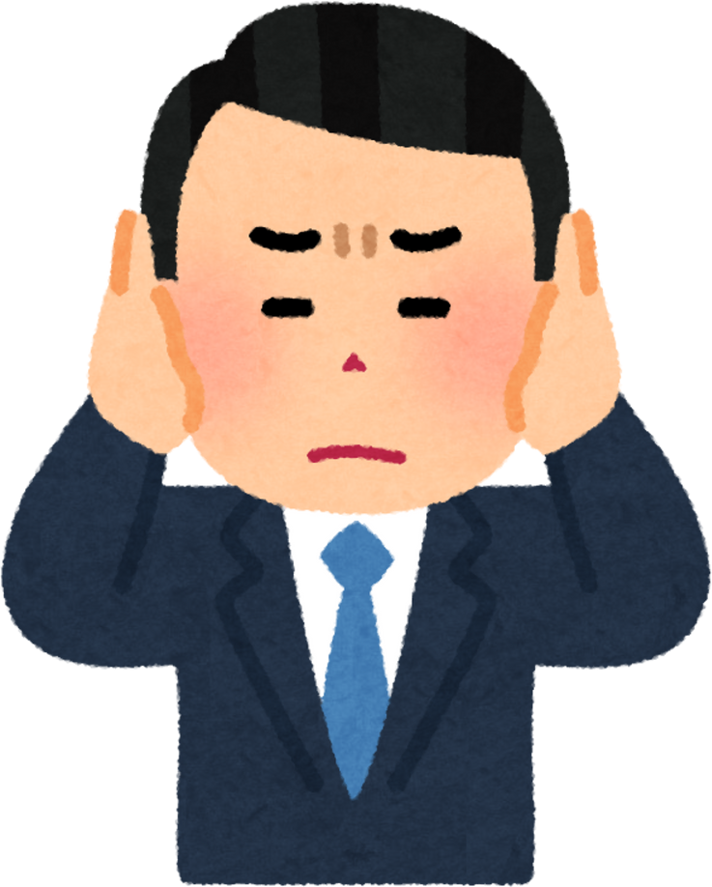
NYC Noise Complaints Analysis
An Analysis for Effective Interventions
Presented by: Nikhil Doye
Date: 06/28/2024

Slide 2
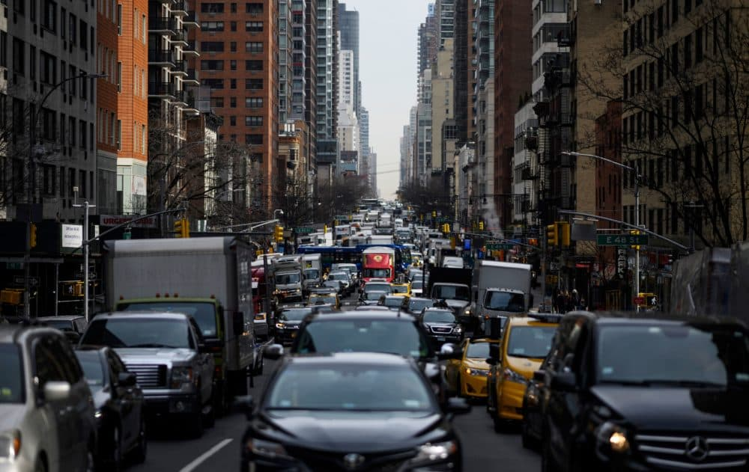
Introduction
Objective
To provide a comprehensive analysis of NYC noise complaints, highlight key insights, and recommend actionable steps to mitigate noise issues.
2

Slide 3
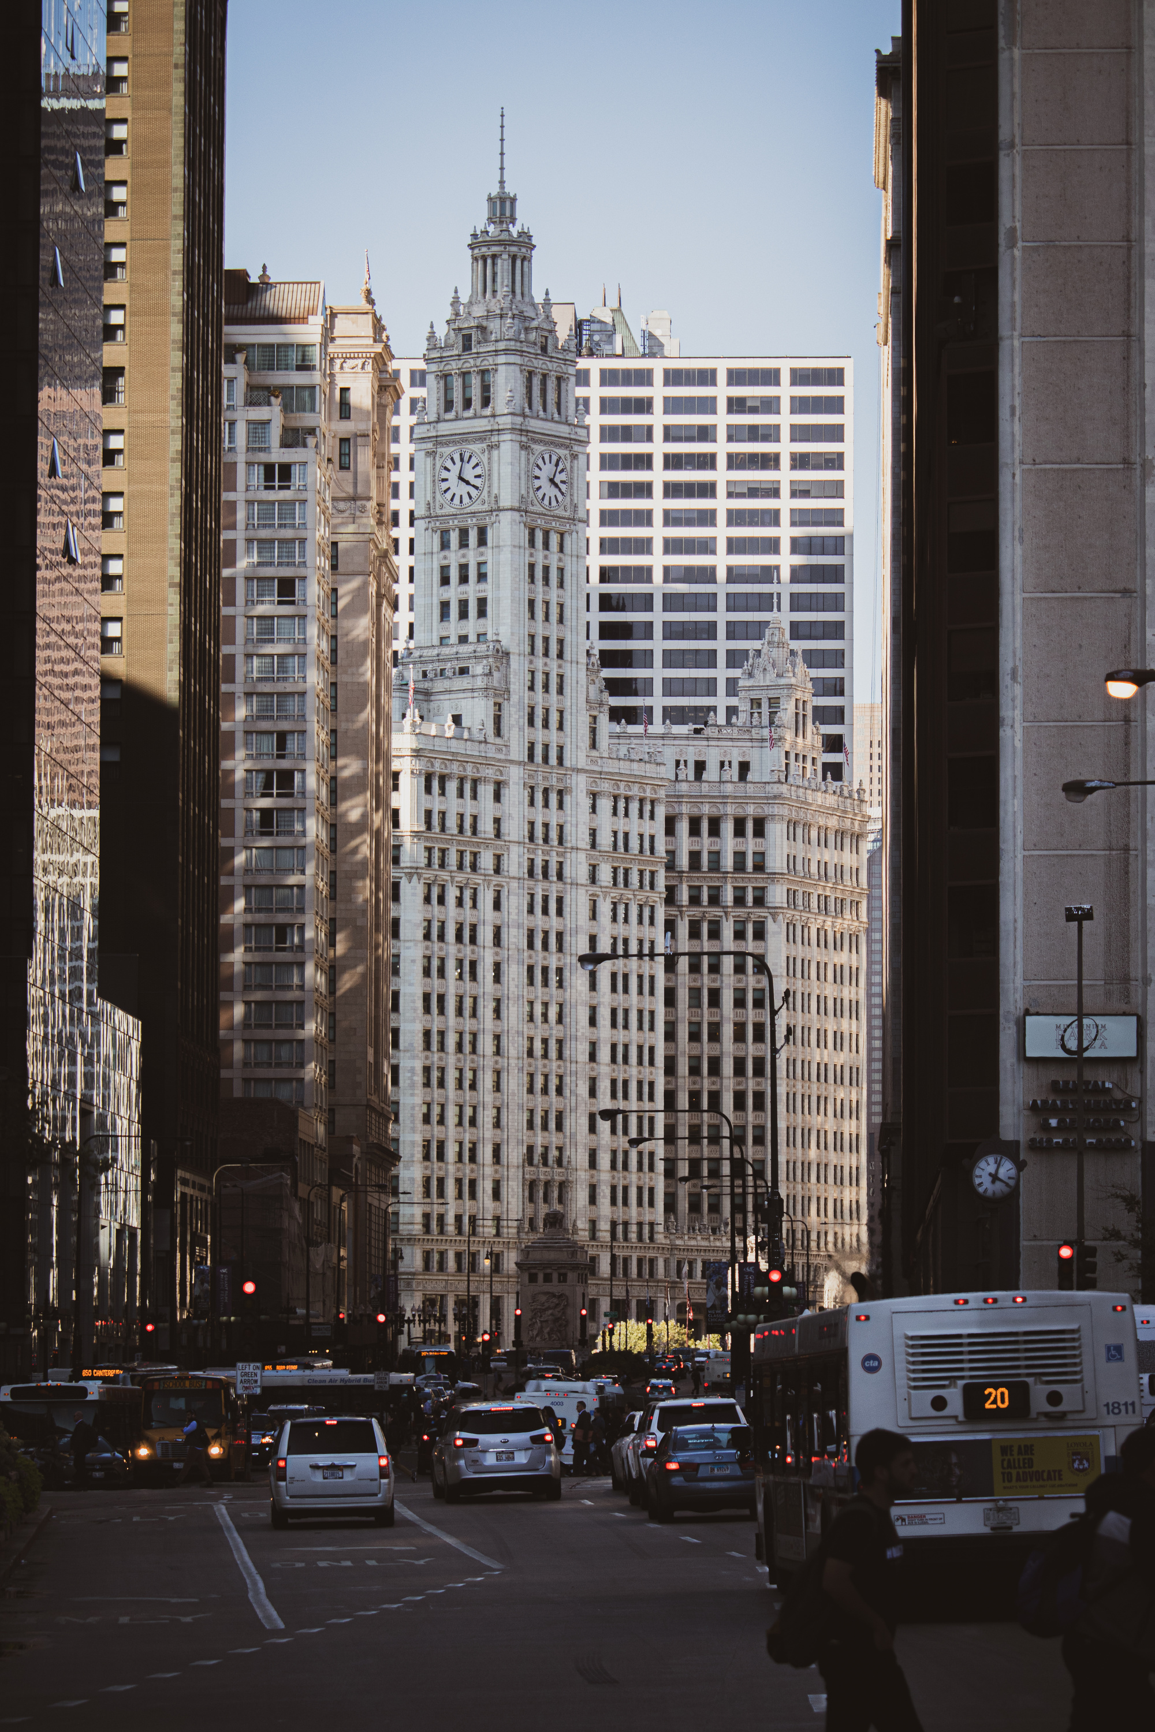
Overview of Noise Complaints
The NYC noise complaints database contains detailed records of complaints received across the city. This analysis covers data from 06/22/2023 to 06/22/2024, examining over 3.3M complaints to identify key trends and actionable insights.
3

Slide 4
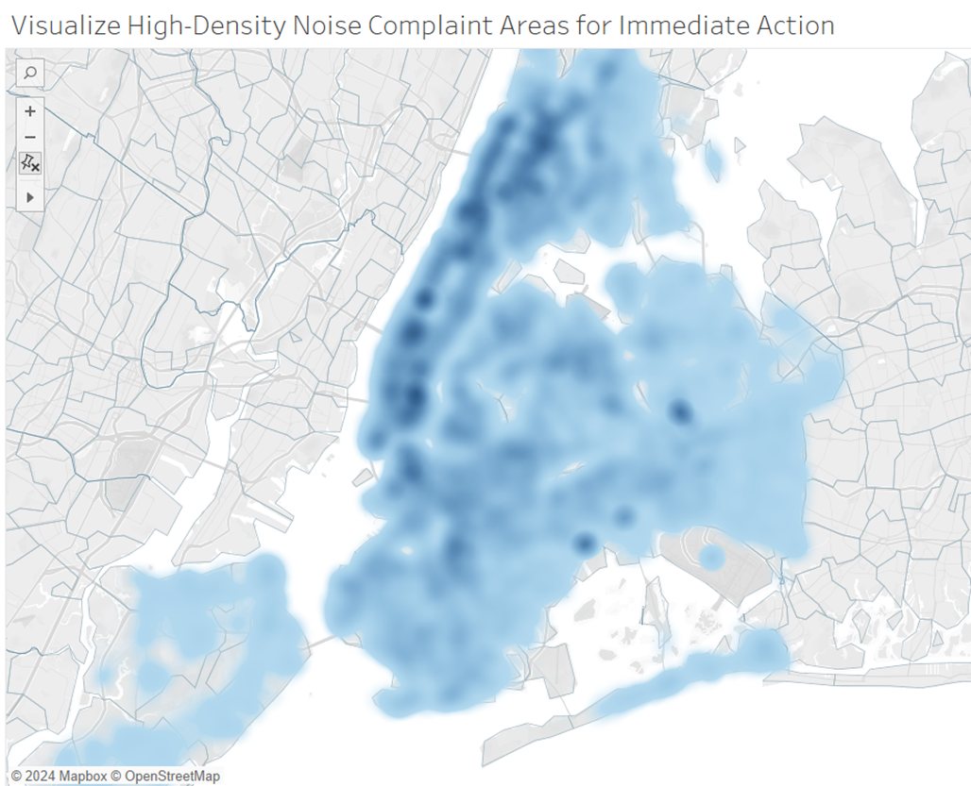
High-Density Noise Complaint Areas for Immediate Action
High-density areas for noise complaints are primarily located in Manhattan and Brooklyn.
Immediate action in these areas can lead to substantial noise reduction.
6

Slide 5
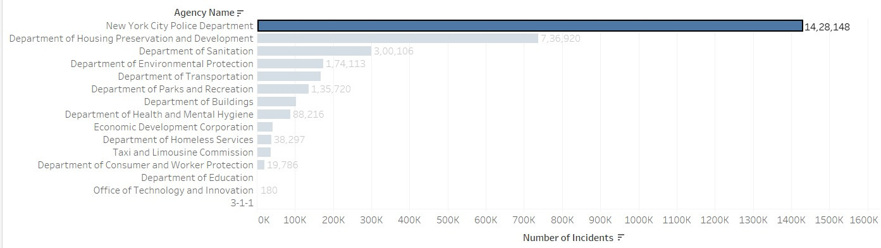
Prominent Agency Names to Target Interventions
The New York City Police Department and the Department of Housing Preservation and Development handle the majority of noise complaints. Focusing interventions on these agencies can significantly impact noise reduction.
4

Slide 6
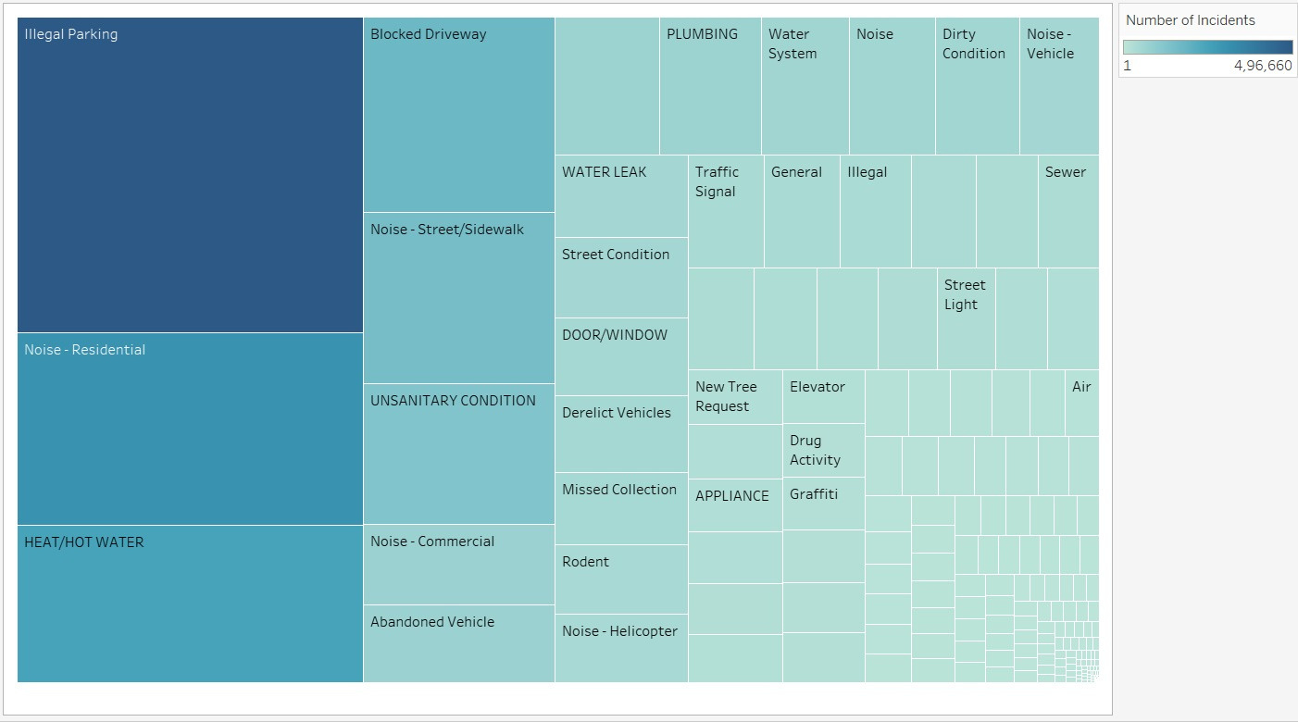

Target Major Sources of Noise Pollution for Effective Solutions
9

Slide 7
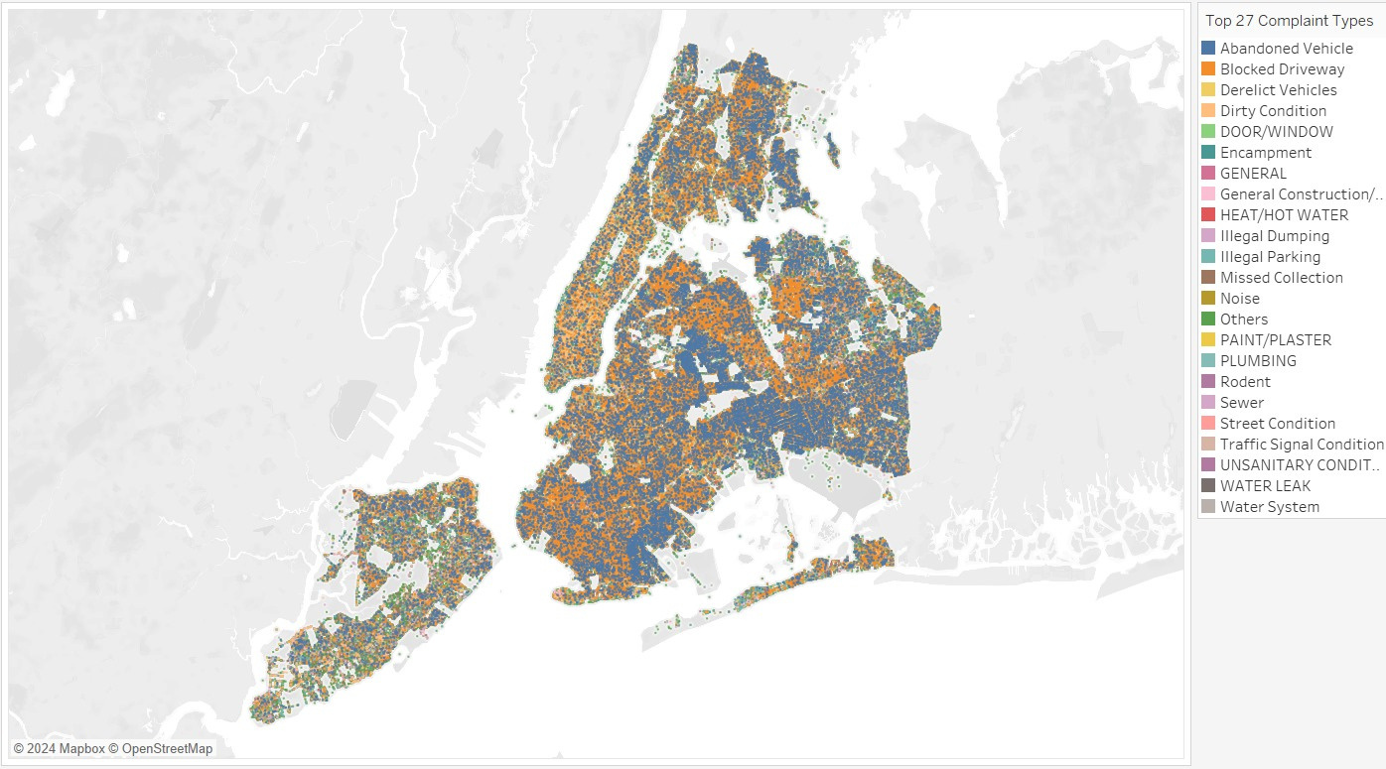

Distribution of Noise Complaint Types to Develop Specific Solutions
5

Slide 8
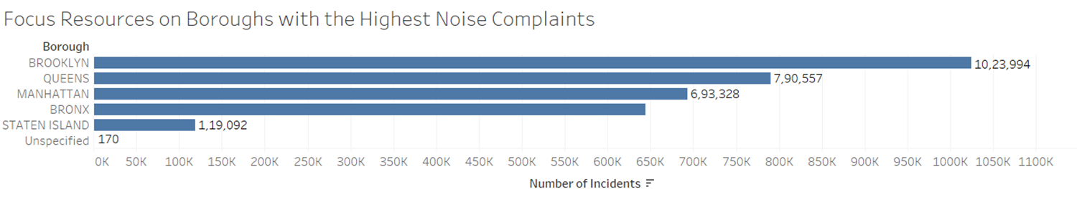
Focus Resources on Boroughs with the Highest Noise Complaints
Brooklyn, Queens, and Manhattan have the highest number of noise complaints. Focusing resources on these boroughs will maximize the impact of noise reduction efforts.
11

Slide 9
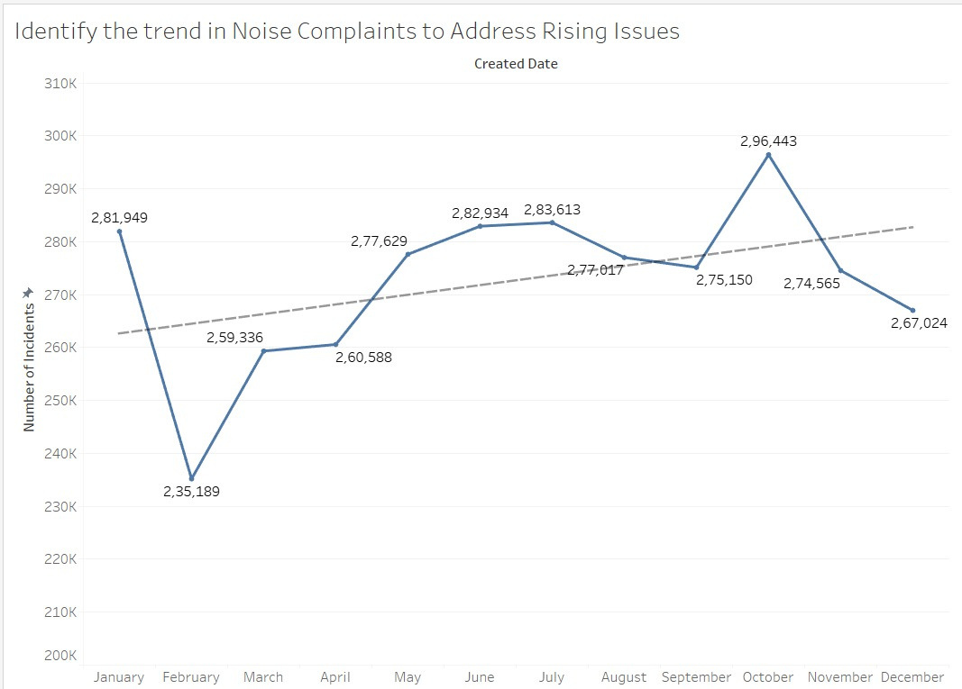
Identify the Trend in Noise Complaints to Address Rising Issues
Based on historical data, noise complaints are expected to continue rising without intervention. Proactive measures can stabilize or reduce complaint levels, improving the quality of life for residents.
10

Slide 10
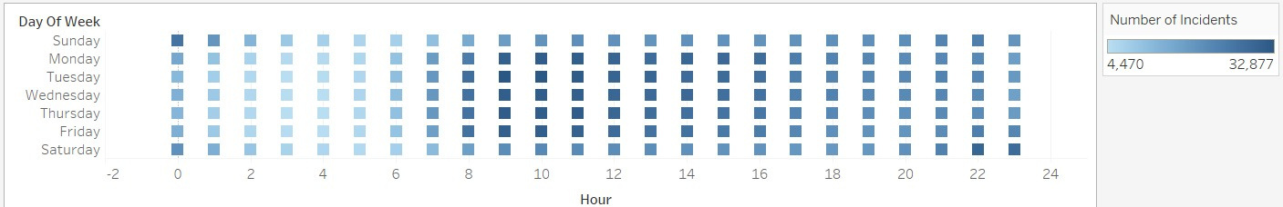
Implement Noise Control Measures During Peak Complaint Hours
Noise complaints peak during morning, afternoons at weekdays and late nights at weekends. Implementing control measures during these times can effectively reduce noise levels.
8

Slide 11
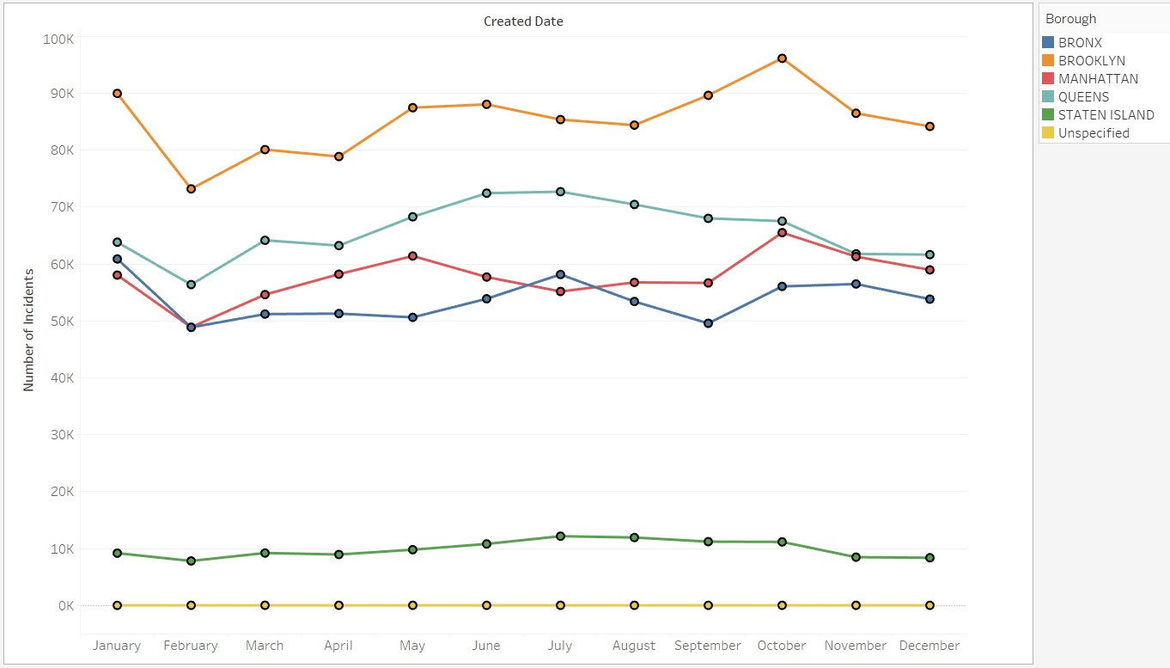
Track Noise Complaint Trends by Borough for Targeted Intervention
Noise complaints vary by borough, with Brooklyn and Manhattan experiencing the highest numbers.
Tracking these trends helps prioritize interventions in the most affected areas.
7

Slide 12
Key Takeaways
Noise complaints are concentrated in Manhattan and Brooklynn.
NYPD and Housing Preventions are burdened with most complaints.
Illegal parking seems to be the biggest source for Noise Complaints.
Boroughs like Brooklynn, Queens and Manhattan require more resources.
Implement noise control measures during days at weekdays and nights at weekends.
Holiday season from September to January is the peak time for complaints.
12

Slide 13
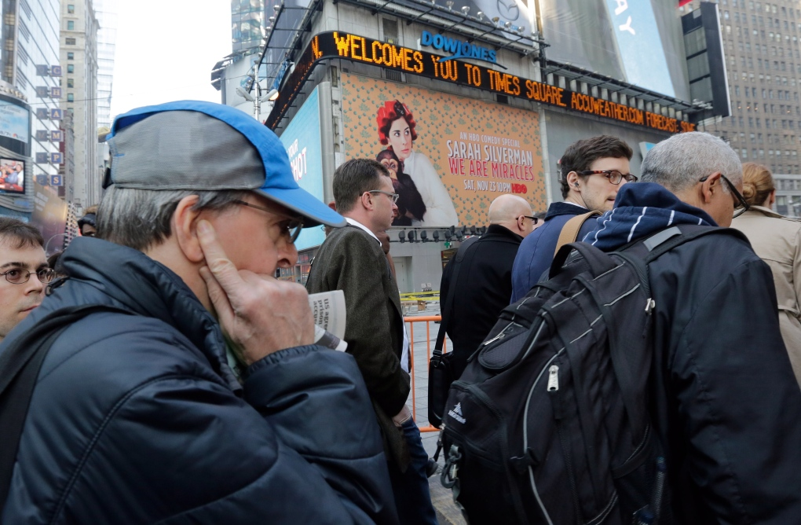
References
NYC 311 Service Requests Database: https://nycopendata.socrata.com/Social-Services/311-Service-Requests-from-2010-to-Present/erm2-nwe9/about_data
13

Slide 14

Thank You

